Slide 1
Toys, Disruptions and the Bleedin’ Obvious
Matt Ballantine
@ballantine70
stamplondon.co.uk/aev

Slide 2
3 stages of technology development
“Obvious”
“Disruption”
“Toy”

Slide 3
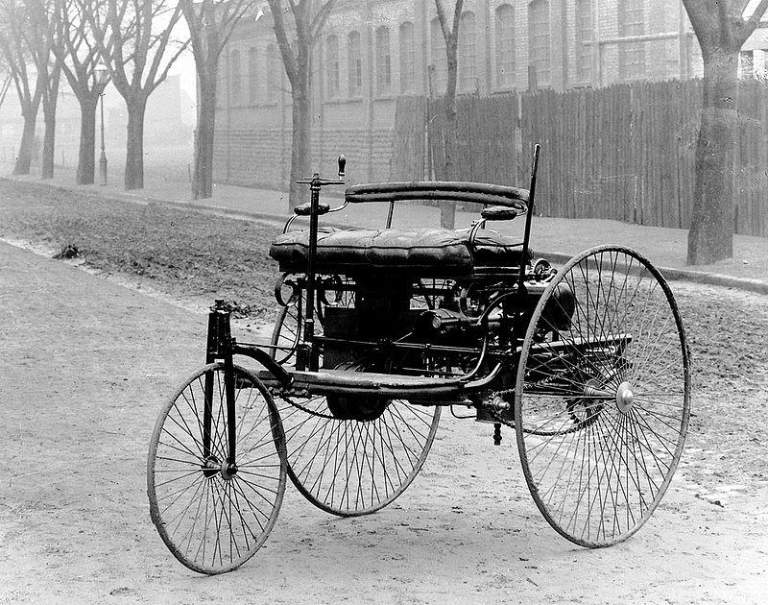
1885
1885

Slide 4
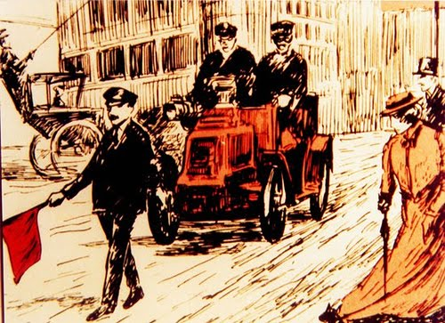

Slide 5
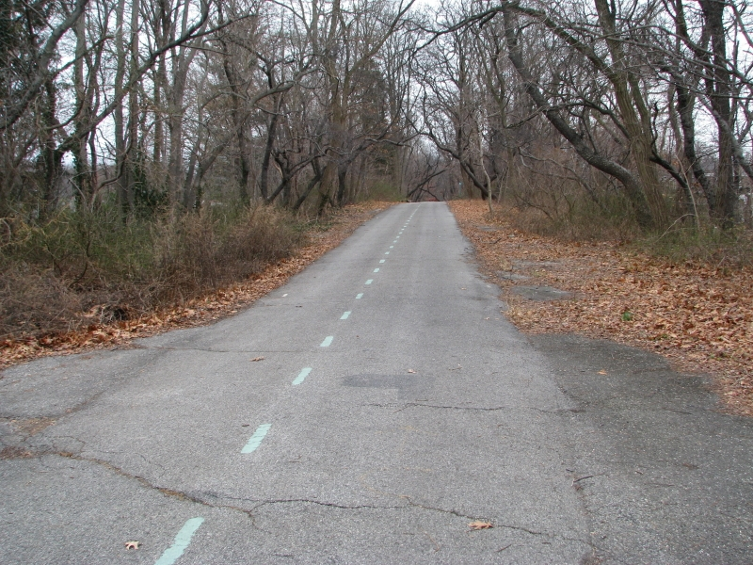
1908
https://commons.wikimedia.org/wiki/File:Lookingeast_2.JPG
1908

Slide 6
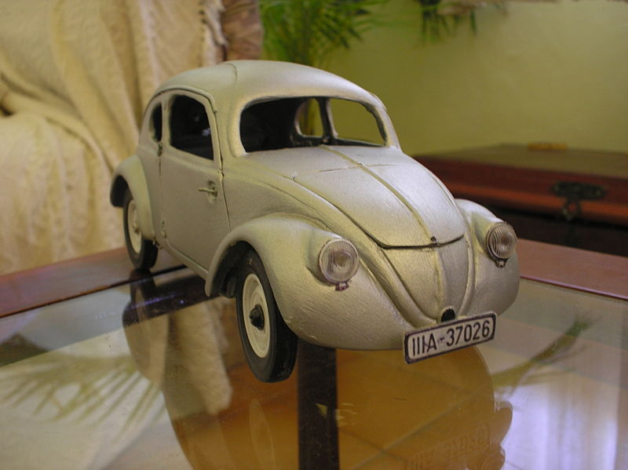
1932
1932

Slide 7
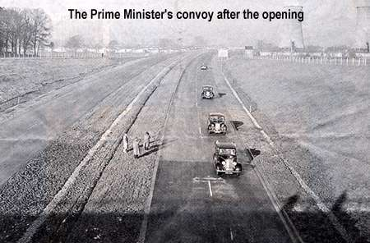
1958
1958

Slide 8
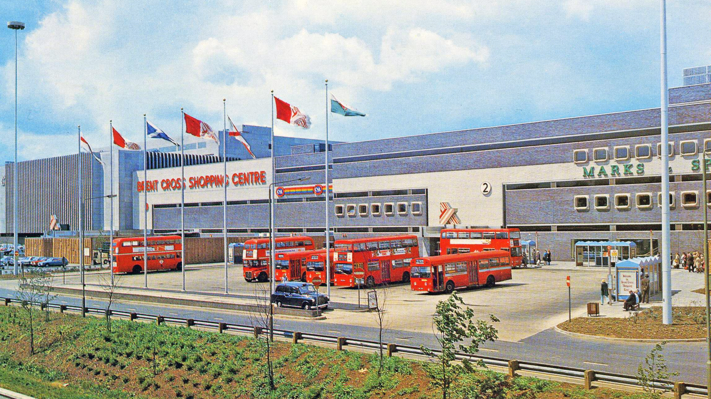
1976
1976

Slide 9
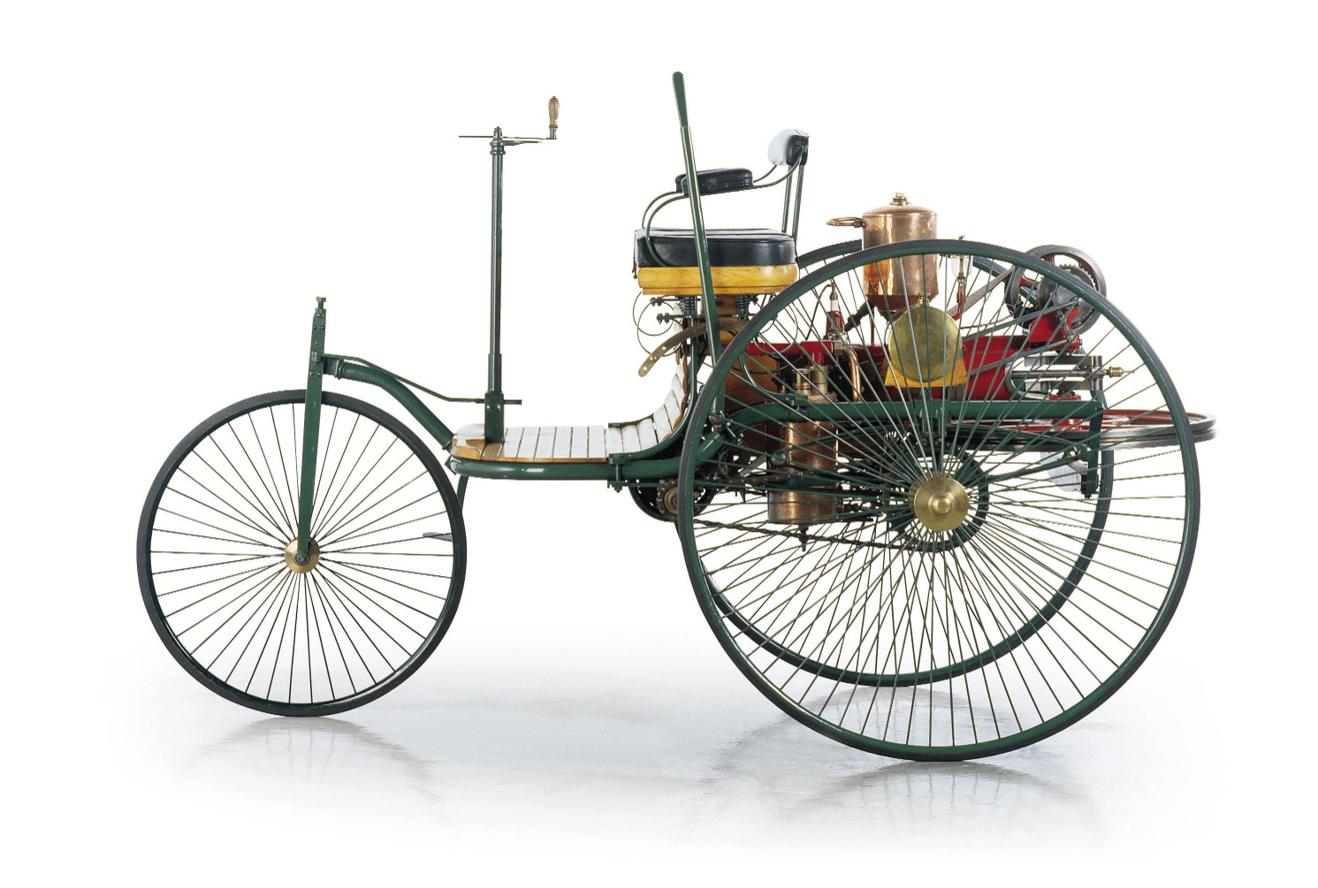



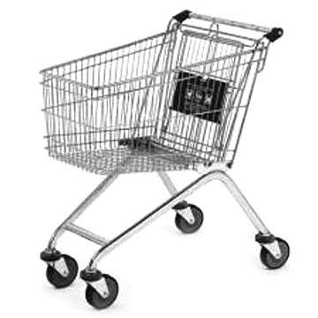
1885
1905
1925
1945
1965
1985
2005
2025
90 Years

Slide 10
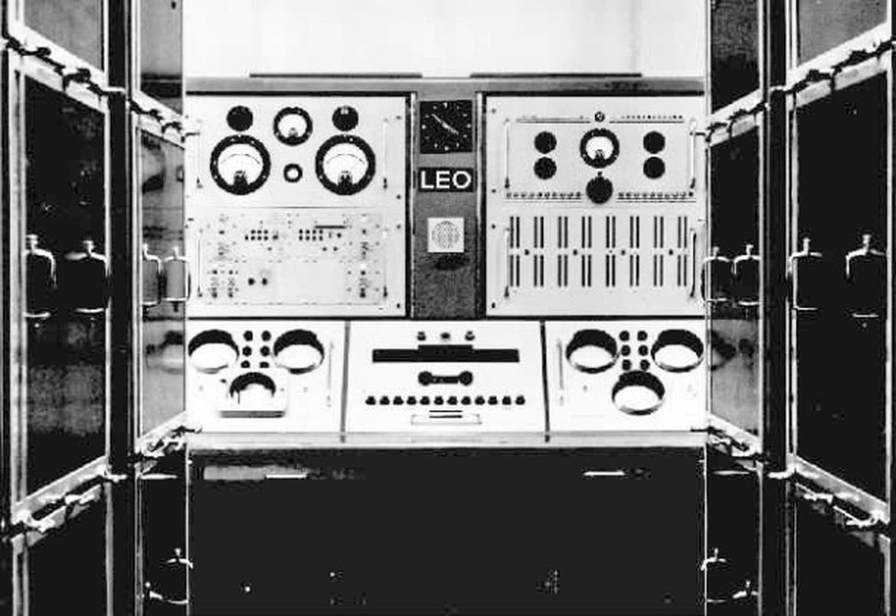
1951
1951

Slide 11
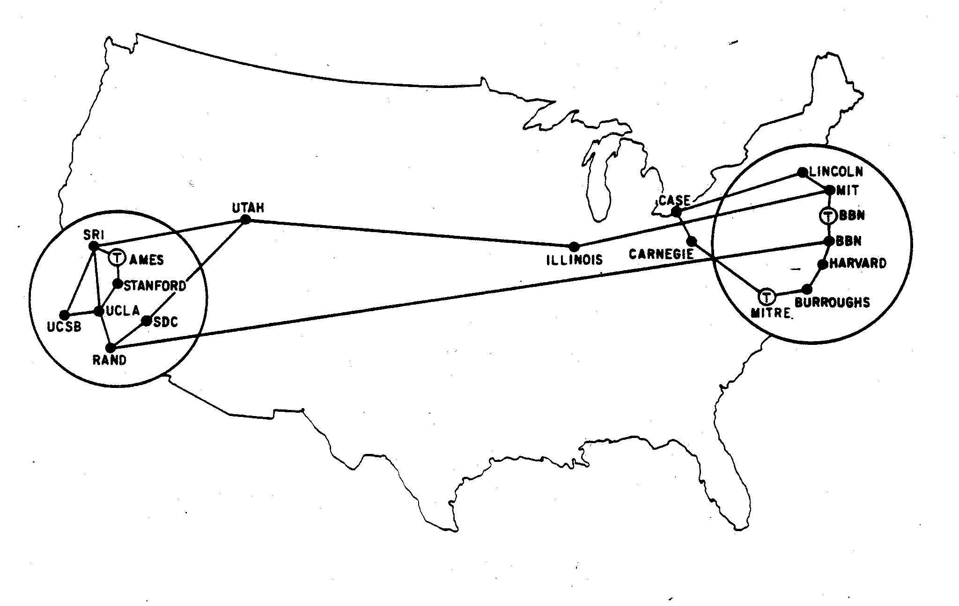
1969

Slide 12
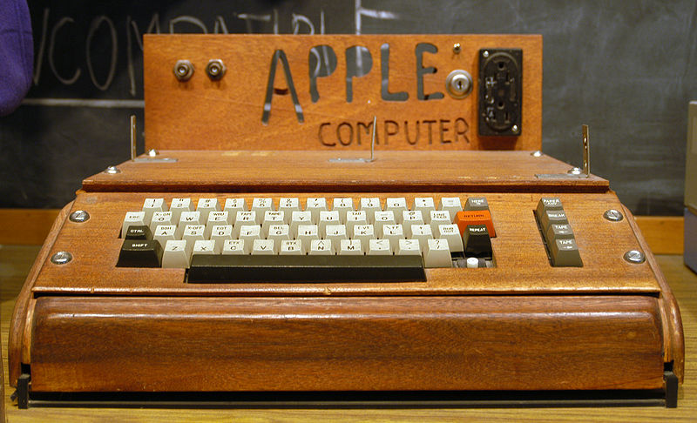
1976
1976

Slide 13
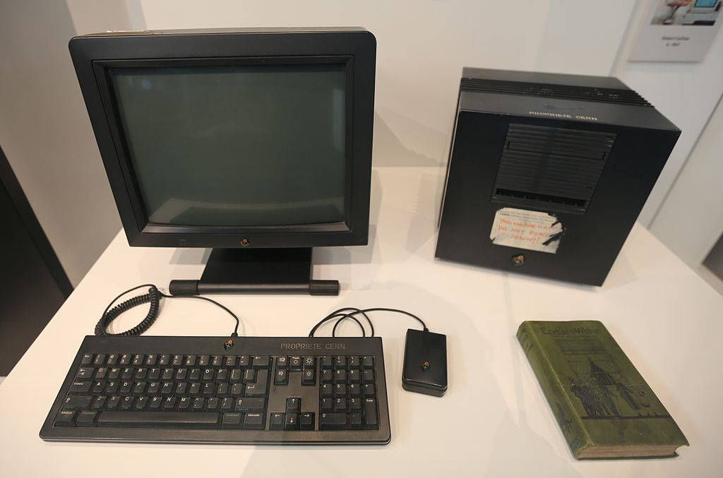
1991
1991

Slide 14
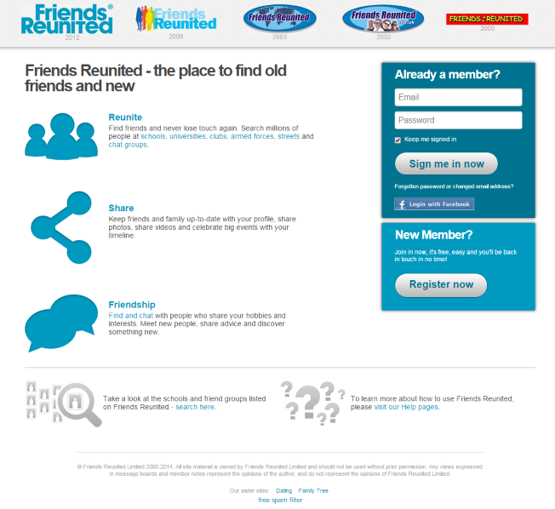
2000

Slide 15

2007

Slide 16
1885
1905
1925
1945
1965
1985
2005
2025
90 Years
90 Years

Slide 17
3 stages of technology development
“Obvious”
Robots
Virtual Reality
Internet of things
Self-driving cars
PC
Internet
Email
Social Networks
“Disruption”
(Big) data
Mobile
Cloud computing
Speech recognition
“Toy”

Slide 18
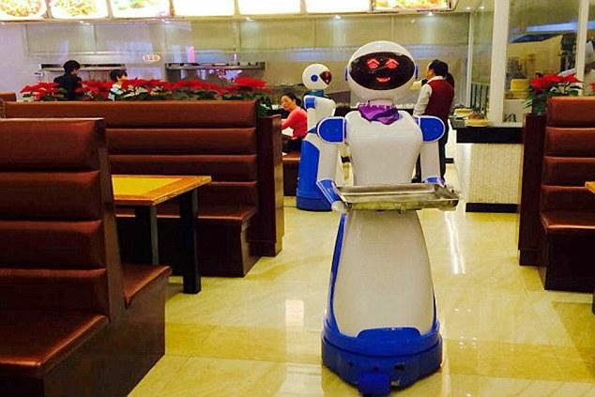
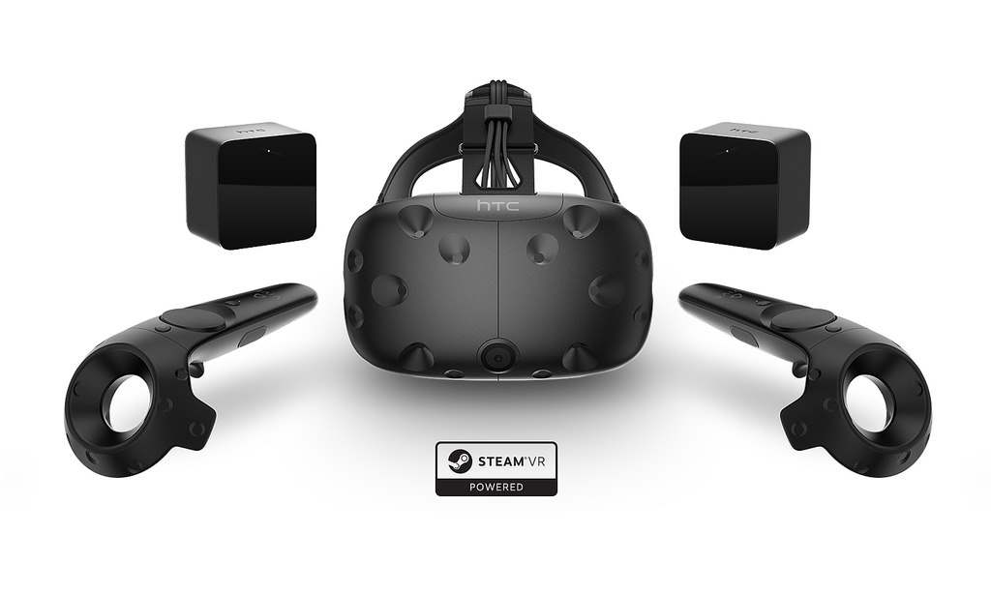
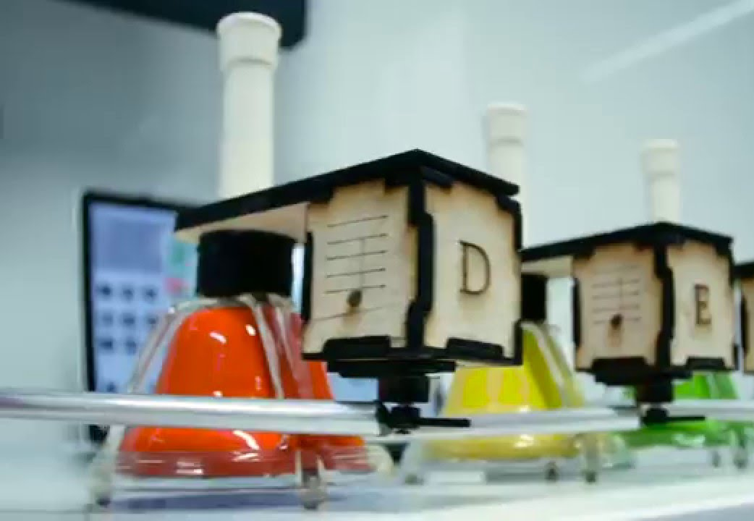
Toys - novelties to play with
Experiment, don’t expect big ROI, brand & reputation

Slide 19
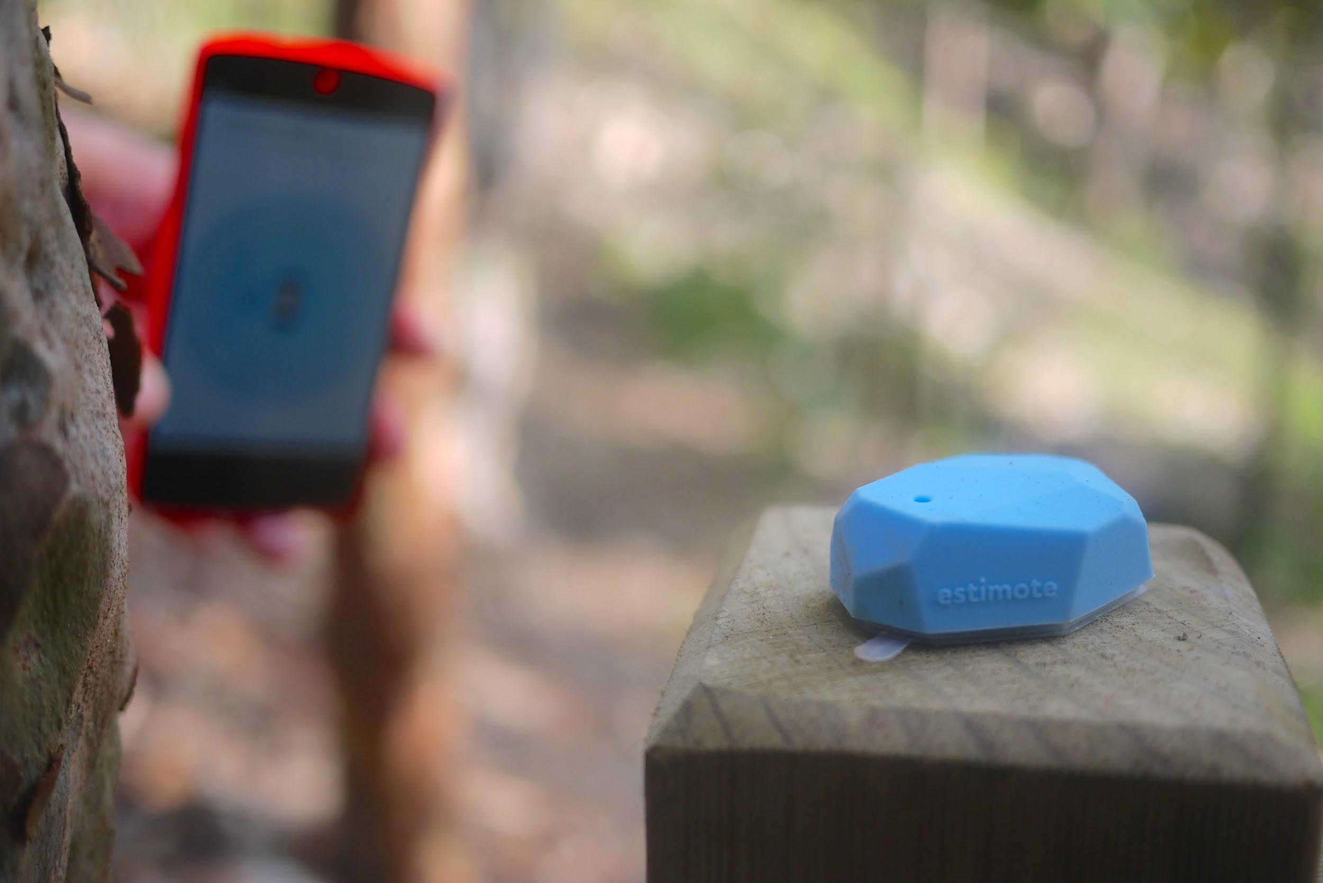
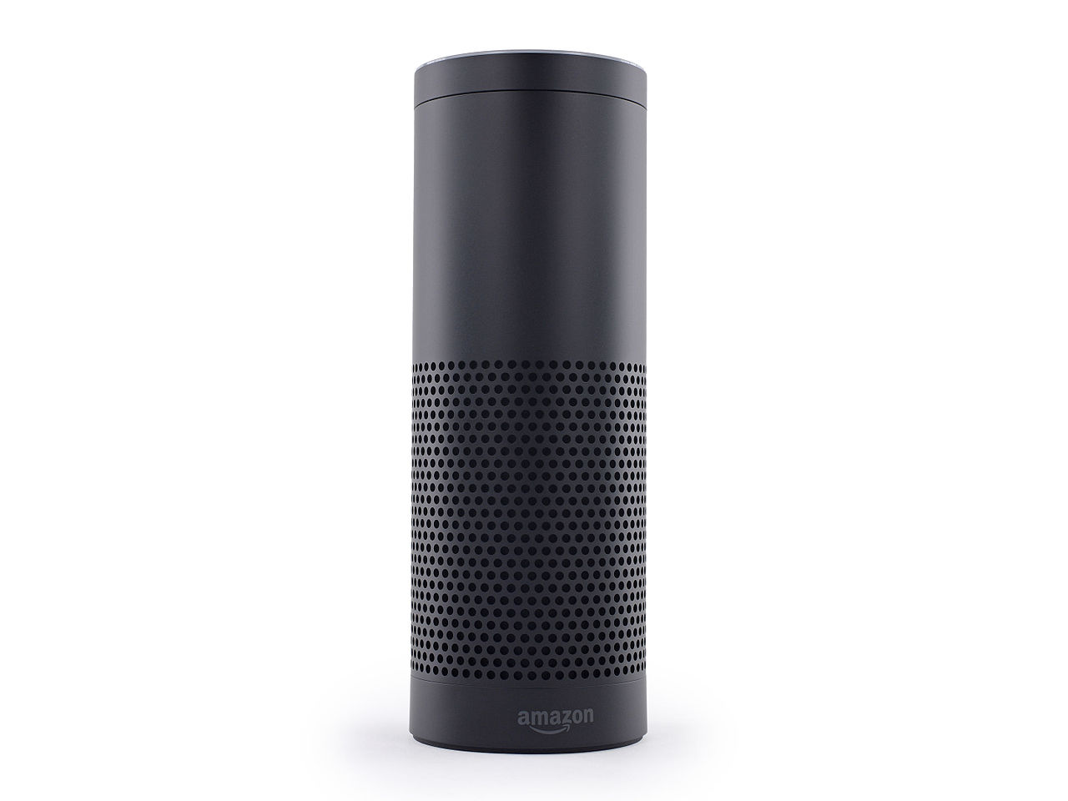

Disruptions - enhancing client & customer experience
Experiment, start small and scale, build on what works

Slide 20



Obvious - efficiency and effectiveness
Good practice, aimed at streamlining and cost saving

Slide 21
3 stages of technology development
“Obvious”
Robots
Virtual Reality
Internet of things
Self-driving cars
PC
Internet
Email
Social Networks
“Disruption”
(Big) data
Mobile
Cloud computing
Speech recognition
“Toy”

